Slide 1



Paper ID: 460
Multi-modal AI Framework for Digital Citizen Automation leveraging Large Language Models, Optical Character Recognition and Translation
Satakshi Poddar, Priyal Banerjee, Tanya Shaw, Deep Suman Dev
Presenter Name: Priyal Banerjee
Affiliation: Department of CSE, MCKV Institute of Engineering
4th International Conference on Advancements in Smart, Secure
and Intelligent Computing
KIIT-DU, Bhubaneswar, India
(08th - 10th August, 2026)

Slide 2
Introduction
Social Lacks (The Problem): In India, accomplishing government paperwork is often confusing and stressful due to long form structures, technical languages, complicated procedures, specialized document requirements, unclear instructions, language barriers and low digital literacy, especially in rural areas.
Technical Lacks: With the evolution and integration of AI these procedures have simplified significantly, but many such frameworks are brittle, static, mostly unimodal and English-centric and suffer from data scarcity, which limits their adaptability and effective digitalization in the Indian demography.
The Proposed Approach: As a counter, this research proposes the Indic-Vision-ASR-NER AI (IVAN AI), a multilingual, multimodal, lightweight and low-data framework for digital form-automation.
Mode 1 (Document Ingestion): OCR ⟶ Machine Translation ⟶ NER
Mode 2 (Voice Ingestion): ASR ⟶ Machine Translation

Slide 3
Objectives
Proposed Research Objectives | Achieved in Current Research | Achieved by IVAN AI
Multilingualism (22+ Indic Languages) | ✗ [1], [3]–[8] | ✓
Multimodality (OCR & ASR) | ✗ [1]–[10] | ✓
Modularity (Distributed Glass-box Pipeline) | ✗ [7] | ✓
Lightweight & Edge-Ready (Low-Resource & On-Premise Deployment) | ✗ [6]–[10] | ✓
Image-Space to English-Text-Space for Simplified Data Requirements (Domain Shift) | ✗ [4]–[8], [10] | ✓
Code-Mixing & Uneven Document Texts Handled (Skewed Mixed Scripts) | ✗ [3]–[5], [7]–[10] | ✓
Immunity to Changing Layouts (non-Layout centric) | ✗ [3]–[5], [7] | ✓
Immunity to Noise & Hallucination (OCR-ASR-Translator-NER) | ✗ [1], [3]–[5], [7] | ✓
Cross-Document Generalization (9 Types) | ✗ [3]–[5] | ✓
Comprehensive Benchmarking | ✗ [6] | ✓
Wide-scale Adaptability and Accessibility | ✗ [1]–[5], [8]–[10] | ✓
Table 1: Comparative Analysis and Research Objectives
All these implemented novelties in the robust IVAN AI framework efficiently mitigates the highlighted social and technical drawbacks, signifying the importance of this research work.

Slide 4
Literature Survey
Recent research activities have significantly focused on,
Accessibility focused voice processing via advanced ASR, for aged and monolingual people [1], [2].
Multimodal approaches for voice and document processing, but lacks cohesive pipeline integration.
Traditional OCR and Regex based information extraction, with DL based image processing [3]–[6].
VLMs, GCN and Generative Information Extraction for document structure and semantic analysis for direct information extraction from images [7], [8].
Cloud APIs, Agents like AWS Textract, GPT-4, etc., and BBN based form-entity mapping [9], [10].

Slide 5









Problem Statement
Accomplishing government paperwork in India is often stressful and laborious because of long structures, technical languages, complicated procedures, unclear instructions, language barriers and low digital literacy, especially in rural areas. Although digital automation using AI tools can simplify this, many current solutions are layout-centric and brittle, hard to improve, mostly Image or English centric and suffer from training data scarcity, thus limiting their usefulness in Indian demography.
Why Governmental Form Automation, Problems and the overall Scenario:
Complex form-filling process
Incomplete Forms and Manual Errors
Multimodality Issues
Confined Languages (English/Hindi)
Not Light Weight and lacks Edge Readiness
Inaccessible to diverse groups (aged/rural/illiterate/disabled)
High Data Requirements (Image/Indic)
Lacks Diversity, Adaptability and Resilience
Unsuccessful attempts to Digital Governance

Slide 6
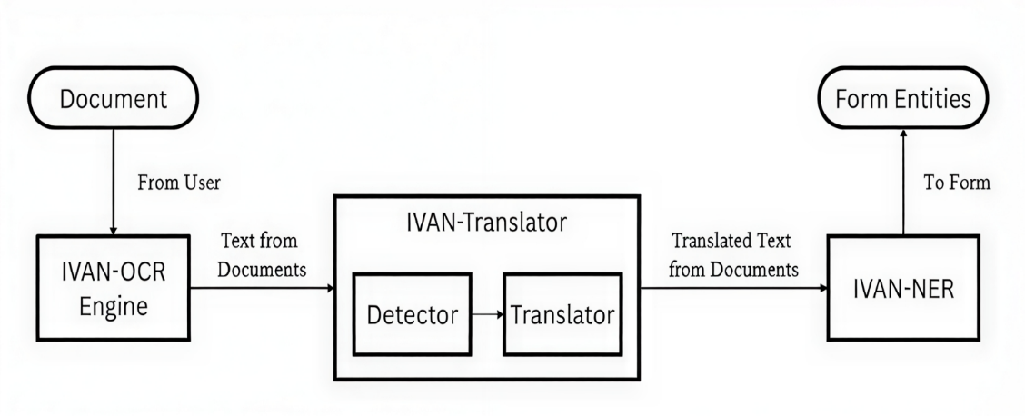
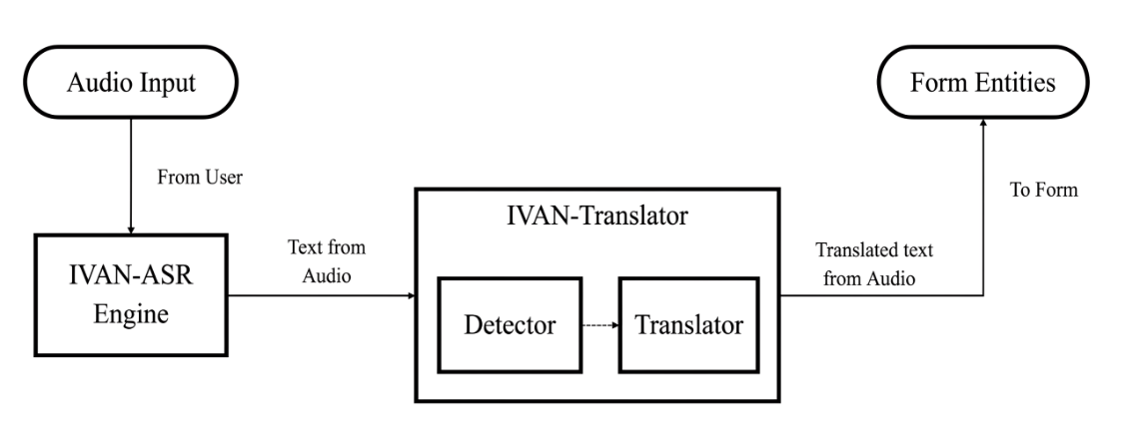
Methodology
IVAN-OCR: Derives texts from diverse government docs (Paddle-Surya Hybrid).
IVAN-ASR (For Voice Modality): Transcribes direct form-specific information as raw speech into texts in JSON form (OpenAI Whisper).
IVAN-Translator: Detects source languages (PolyGlot) of OCR-derived or ASR-transcribed texts and translates (nllb-200) them to a user specified target language.
IVAN-NER: Extracts form-field entities from OCR-translated texts (BERT-large, trained on IVAN-NER Dataset, a 100 samples English-text set from 9 government docs, manually annotated on 21 distinct form-entities) as JSON and auto-populates forms.
Figure 1: OCR-Translator-NER Pipeline
Figure 2: ASR-Translator Pipeline

Slide 7
Results and Discussion
The comparative analysis of IVAN-OCR: Processing latency per document is 3.46s.
Model/System | WER | Constraints
Tesseract (English, Real Hist. Books) [6] | 26.70 | Complex, brittle & no code-mixing
GOT OCR (English, Real Hist. Books) [6] | 20.29 | Complex, brittle & no code-mixing
GPT-4o (English, Real Hist. Books) [6] | 3.43 | Complex, brittle & no code-mixing
IVAN-OCR (Paddle-Surya Hybrid) – Proposed in this paper | 57.31 | —
Table 2: Comparative Benchmarking of IVAN-OCR (on WER)
Model/System | F1-score | Constraints
SCAN + GOT-580M (OHR-Bench) [7] | 30.8 | Highly complex architecture
SCAN + Qwen2.5-VL-72B (OHR-Bench) [7] | 33.8 | Highly complex architecture
IVAN-OCR (Paddle-Surya Hybrid) – Proposed in this paper | 77.81 | —
Table 3: Comparative Benchmarking of IVAN-OCR (on F1-score)

Slide 8
Results and Discussion
The analysis of IVAN-ASR: Processing latency per voice input is 3.02s.
Model/System | WER | Constraints
IndicWhisper (Vistaar Benchmark) [2] | 24.6 | Static, no deployment tests & data annotation labour
Google STT (Vistaar Benchmark) [2] | 44.3 | Static, no deployment tests & data annotation labour
IndicWav2Vec (Vistaar Benchmark) [2] | 28.7 | Static, no deployment tests & data annotation labour
Dhvani [1] | 3.00 | Only for Kannada language
IVAN-ASR (OpenAI Whisper) – Proposed in this paper | 58.08 | —
Table 4: Comparative Benchmarking of IVAN-ASR (on WER)
Model/System | BERTScore (F1-score) | Constraints
Dhvani [1] | 97 | Only for Kannada language
IVAN-ASR (OpenAI Whisper) – Proposed in this paper | 92.33 | —
Table 5: Comparative Benchmarking of IVAN-ASR (on F1-score)

Slide 9
Results and Discussion
The analysis of IVAN-Translator: Overall processing latency per text sample is 0.297s.
Model/System | BERTScore (F1-score)
Translation (nllb-200-distilled-600M) – Proposed in this paper | 94.78
Language Detection (PolyGlot) – Proposed in this paper | 78.33
Overall (Unified) – Proposed in this paper | 86.55
Table 6: Benchmarking of IVAN-Translator (on F1-score)
The comparative analysis of IVAN-NER: Processing latency per OCRed document is 0.062s.
Model/System | F1-score | Constraints
Ensemble (Claude-3.5 + GPT-4 + Gemini) [9] | 94.7 | English only, API costs and data privacy issues
LAFF (Bayesian Network, NCBI) [10] | 73 | Complex, inefficient and massive historical data
LAFF (Bayesian Network, Banking) [10] | 78 | Complex, inefficient and massive historical data
IVAN-NER (BERT-Doc-NER-Max) – Proposed in this paper | 79.8 | —
Table 7: Comparative Benchmarking of IVAN-NER (on F1-score)

Slide 10
Conclusion and Future Scope
A Concluding Summary: This research introduces IVAN AI, integrated and optimized as a lightweight, easy-to-use multimodal framework for form-automation in India’s complex, code-mixed, multilingual landscape. This modular, edge-ready solution bridges significant research gaps in this resource-constrained NLP domain with considerable benchmarks and novelties with high enhancement potential, offering a robust and adaptable blueprint for enhancing digital governance, service delivery and accessibility.
Limitations of the Framework: Limited training data (100 annotated samples), legal restrictions to data generation, not properly optimized for numeric-only strings and handwritten inputs.
Future Improvements: Data augmentation with noisy OCR-samples, optimize IVAN-OCR on handwritten documents, optimize IVAN-ASR and IVAN-Translator on numeric-strings and complex ascents, design privacy and edge-deployment protocols for IVAN AI framework.

Slide 11
References
[1] A. R. Hegde et al., “Automated government form filling for aged and monolingual people using interactive tool,” Disability and Rehabilitation: Assistive Technology, vol. 19, no. 6, pp. 2260–2270, 2024, DOI: 10.1080/17483107.2023.2277825.
[2] K. S. Bhogale et al., “Vistaar: Diverse benchmarks and training sets for Indian language ASR,” arXiv, vol. abs/2305.15386, pp. 1–6, Aug. 2023, DOI: 10.48550/arXiv.2305.15386.
[3] R. Tewani, A. K. Dubey, A. Jain, E. Agarwal, and D. Mittal, “An efficient extraction of information from Indian Government issued documents Aadhar and PAN Card,” Fusion Practice and Applications, vol. 4, no. 2, pp. 56–61, 2021, DOI: 10.54216/FPA.040201.
[4] S. Raghuvanshi, S. Girase, S. Patil, S. Chaudhari, and M. Ahirrao, “An end-to-end AI system for automated verification of Indian identity documents using OCR and large language models,” Int. J. Adv. Res. Sci. Commun. Technol., vol. 5, pp. 160–169, 2025, DOI: 10.48175/IJARSCT-29919.
[5] S. R. Narendranaath, S. Muralidharan, R. Krishna Sai Ram, and V. Prema, “Automated OCR-based PAN card text extraction system,” Int. J. Res. Trends Innov. (IJRTI), vol. 10, no. 3, pp. B47–B53, Mar. 2025.

Slide 12
References
[6] S. Guan et al., “PreP-OCR: A complete pipeline for document image restoration and enhanced OCR accuracy,” arXiv, vol. abs/2505.20429, pp. 1–17, May 2025, DOI: 10.48550/arXiv.2505.20429
[7] Y. Dong et al., “SCAN: Semantic document layout analysis for textual and visual retrieval-augmented generation,” arXiv, vol. abs/2505.14381, pp. 1–20, Dec. 2025, DOI: 10.48550/arXiv.2505.14381.
[8] V. Ojha, “Automated Information Extraction System,” DataToBiz, 2024.
[9] R. K. Komma, “AI-powered vendor form automation: A comprehensive technical analysis of enterprise implementation,” Int. J. Sci. Res. Comput. Sci. Eng. Inf. Technol., vol. 11, no. 1, pp. 2975–2983, Jan.– Feb. 2025, DOI: 10.32628/CSEIT251112285
[10] H. Belgacem, X. Li, D. Bianculli, and L. C. Briand, “A machine learning approach for automated filling of categorical fields in data entry forms,” ACM Trans. Softw. Eng. Methodol., vol. 1, no. 1, Art. 1, 2022, DOI: 10.48550/arXiv.2202.08572.

Slide 13
Thank You

